Slide 1

MCST 1043
RESEARCH DESIGN AND ANALYSIS
SENTIMENT ANALYSIS ON HOTEL REVIEW USING MACHINE LEARNING
CANDIDATE LECTURER DATE
: NURFATINI ATIQAH BINTI HAMIDI
: ASSOC PROF DR MOHD SHAHIZAN OTHMAN
: 17 JANUARY 2025
FACULTY OF COMPUTING, UNIVERSITI TEKNOLOGI MALAYSIA

Slide 2
Content
01
Introduction
101001101001000010101001001110010101100101010011101010001010100010110101101101101000101011100010101000101000101110101100010011010011010010001110111011011011010101000101
02
Literature Review
03
Research Methodology
04
Initial Findings
05
Conclusion

Slide 3

INTRODUCTION

Slide 4


INTRODUCTION
PROBLEM BACKGROUND AND STATEMENT
Problem Background:
Online reviews significantly impact consumer decision-making, particularly in the hospitality industry
Platforms like TripAdvisor, Agoda, and Booking.com receive thousands of reviews reflecting customer experiences and emotions
Manual tracking and extracting information from extensive reviews is time-consuming and inefficient
Problem Statement:
Inconsistencies between written reviews and star ratings lead to confusion and misinterpretation.
Reviews are critical for shaping a hotel’s online reputation and influencing customer decisions

Slide 5

INTRODUCTION
OBJECTIVES
01
02
03
To conduct exploratory data analysis to identify patterns of hotel reviews
To design and implement sentiment analysis that predict the review either positive or negative.
To conduct comprehensive evaluations on the develops predictive model and build an interactive dashboard.

Slide 6


INTRODUCTION
RESEARCH SCOPE
Open-source dataset from Kaggle
Two Sentiment Analysis
(+ve and –ve)
Machine Learning: TF-IDF and K-Means

Slide 7

LITERATURE REVIEW

Slide 8


LITERATURE REVIEW
THEORETICAL FRAMEWORK
Lexicon-Based
Machine Learning
Hybrid
Sentiment Analysis
uses classification technique to classify text
involves gathering tokens, with each token linked to a specific score
addition of machine learning and Lexicon-based approach.
Type of approach | Advantages | Limitation
Machine Learning | The capability to adjust and develop trained models for particular uses and situations. | The limited applicability to new data arises from the need for labelled data, which can be expensive or even unaffordable.
Lexicon-based | Broader term inclusion, annotated data, and the process of learning are not necessary. | A restricted set of words in the lexicons is assigned a particular sentiment orientation and score for each word
Hybrid | Lexicon/learning symbiosis involves identifying and gauging sentiment at the conceptual level, along with reduced sensitivity to shifts in topic domain. | Noisy reviews

Slide 9
LITERATURE REVIEW
MACHINE LEARNING APPROACH
a prevalent technique used to assess the significance of a word within a document
Random forest is an ensemble technique that generates multiple decision trees, which are then combined into a forest. Each tree in the Random Forest makes a class prediction and the Random Forest determines the outcome based on tge majority of votes.
SVM finds the optimal hyperplane (a decision boundary) that separates data points into distinct classes with the maximum margin between them.
The Term Frequency-Inverse Document Frequency (TF-IDF)
Random Forest
Support Vector Machine (SVM)

Slide 10

LITERATURE REVIEW
DATA AND METHODS COMPARISON
Author | Dataset | Features | Classifier | Accuracy (%)
(Rathi et al., 2018) | Sentiment140, Polarity Dataset, and University of Michigan dataset | TF-IDF | AdaBoost | 67
(Makhmudah et al., 2019) | Tweets related to homosexuals | TF-IDF | Support Vector Machine (SVM) | 99.5
(Gupta et al., 2019) | Sentiment140 | TF-IDF | Neural Network | 80
(Alsalman, 2020) | Arabic Tweets | TF-IDF | Multinomial Naïve Bayes | 87.5
(Alzyout et al., 2021) | Self-collected dataset | TF-IDF | Support Vector Machine (SVM) | 78.25

Slide 11

RESEARCH METHODOLOGY

Slide 12


RESEARCH METHODOLOGY
RESEARCH FRAMEWORK
04 SENTIMENT ALGORITHM
03 FEATURE EXTRACTION
02 DATA PRE-PROCESSING
01 DATA COLLECTION
Focus on Peninsular Malaysia, excluding East Malaysia due to differing climatic and ecological conditions, select state based on previous studies, to provide a localized analysis of forest fire patterns and their relationship with climatic factors.

Slide 13




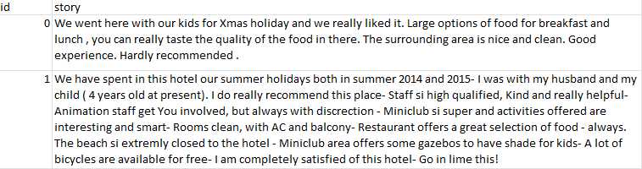
RESEARCH METHODOLOGY
DATA COLLECTION
Transform
Size: 1,100,001
Attribute:
Id
story

Slide 14
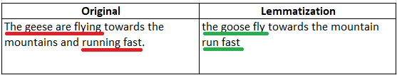

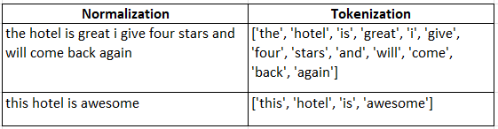
RESEARCH METHODOLOGY
DATA PRE-PROCESSING
DATA CLEANING
Normalization
Lemmatization
Tokenization

Slide 15
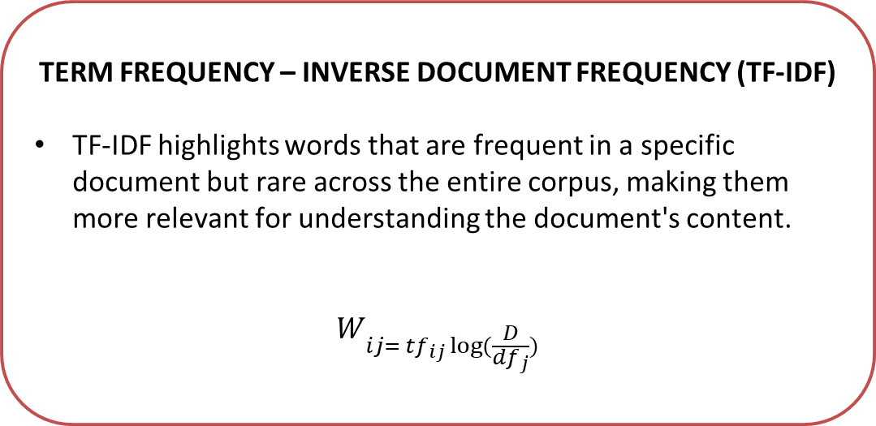
RESEARCH METHODOLOGY
FEATURE EXTRACTION
EXAMPLE:
TERM FREQUENCY – INVERSE DOCUMENT FREQUENCY (TF-IDF)
TF-IDF highlights words that are frequent in a specific document but rare across the entire corpus, making them more relevant for understanding the document's content.
$$W_{ij= {tf}_{ij }log⁡(\frac{D}{{df}_{j}})}$$
consider a document that consists of 100 words, with the word “happy” occurring 10 times. In this case, the term frequency would be calculated as 10/100=0.1. Now, let's assume there are 50000 documents in total, and only 500 of those contain the word “happy.” Therefore, the IDF (happy) can be expressed as 50000/500=100, resulting in log(100) = 2. Consequently, the TF-IDF (happy) would be 0.1*2= 0.2

Slide 16
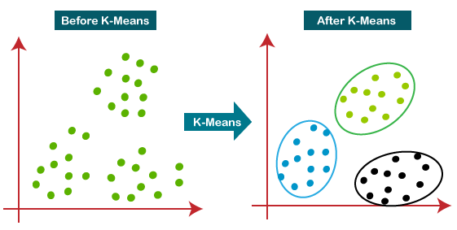
RESEARCH METHODOLOGY
SENTIMENT ALGORITHM
K-Means clustering is one of the machine learning algorithms used for grouping data points into clusters based on their similarity
K-MEANS CLUSTERING

Slide 17
INITIAL FINDINGS

Slide 18


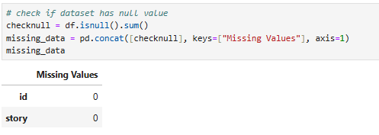
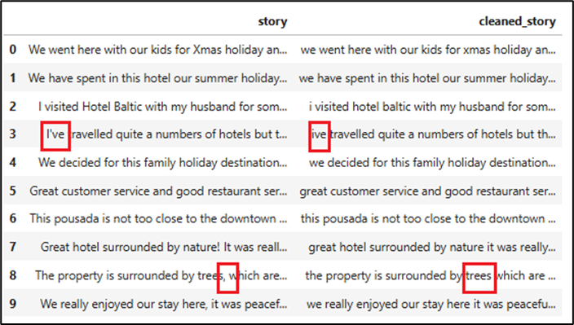
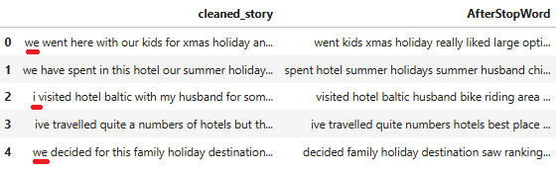
INITIAL FINDINGS
EXPLORATORY DATA ANALYSIS (EDA) python
Check missing values
Remove punctuation
Implement stop words

Slide 19
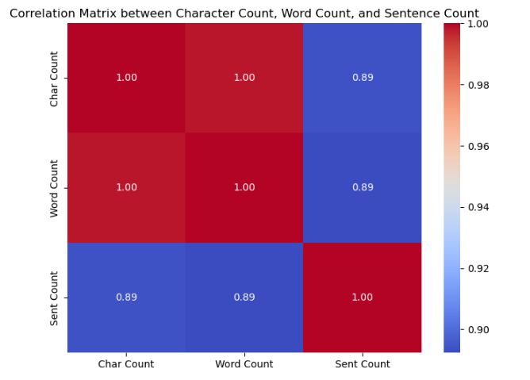
INITIAL FINDINGS
EXPLORATORY DATA ANALYSIS (EDA) python
The character count and word count strongly correlate positively. While character count and sentence count have a moderate correlation that depends on sentence length.

Slide 20
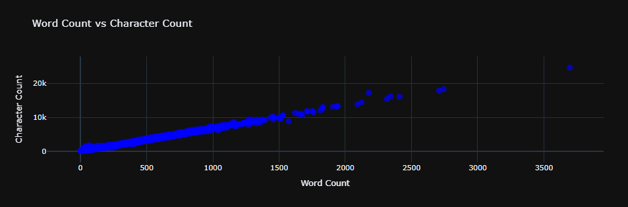
INITIAL FINDINGS
EXPLORATORY DATA ANALYSIS (EDA) python
Positive correlation between word count and character count

Slide 21
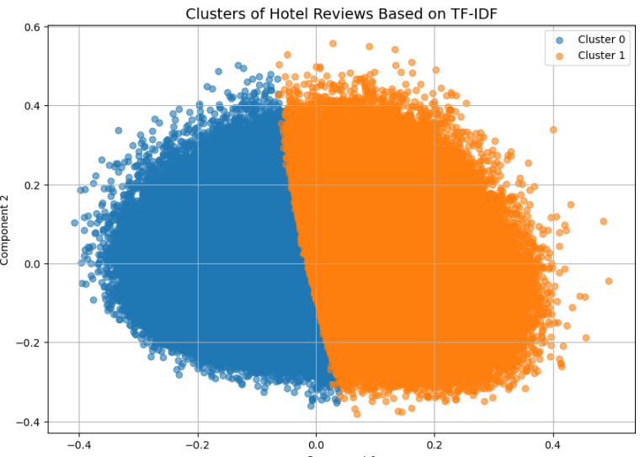
INITIAL FINDINGS
EXPLORATORY DATA ANALYSIS (EDA) python
The proportion of two distinct groups, represented by the blue and orange colors. The blue represents the cluster 0 while the orange represents the cluster 1. In this cluster, 0 represent positive and 1 represent negative.

Slide 22
CONCLUSION

Slide 23
CONCLUSION
SUMMARY
This study has achieved the objective, to identify the patterns in hotel reviews:
From the analysis, it can be found that word count and character count increase together.Word count links better with character count than sentence count (due to cleaning).
Used TF-IDF to find the 500 most important words.
Used K-Means to sort reviews into positive and negative groups.
Sentiments form clear clusters, but some overlap and outliers exist.

Slide 24
CONCLUSION
FUTURE WORKS
Improve Preprocessing:
Use advanced techniques like stemming, lemmatization, and part-of-speech tagging to clean noisy data better.
Expand Sentiment Categories:
Move beyond just positive and negative sentiments. Include neutral or mixed opinions for more detailed analysis.
Use Advanced Models:
Replace traditional methods like K-Means with deep learning models like LSTM or BERT.

Slide 25


